Slide 1

Project Review-1
on
Gesture Based Virtual Reality Systems
by Shyam S (1041210549, Y4) Mohammed Sadique (1041210566, Y4)
Geetha R (1041210579, Y4)
Under the guidance of
MR. M.Mario Dominic Savio
Assistant Professor (O.G), Department of ECE
Department of ECE

Slide 2
What is an VR?
Virtual reality or virtual realities (VR), which can be referred to as immersive multimedia or computer-simulated reality, replicates an environment that simulates a physical presence in places in the real world or an imagined world, allowing the user to interact in that world. Virtual realities artificially create sensory experiences, which can include sight, touch, hearing, and smell.

Slide 3
Introductions
Modern world relies on several mediums for communication and one of the most immersive of them all is the electronics entertainment systems.current generation of electronics relies heavily on audio , visual and rumble trigger feedbacks. Whereas the next generation will rely on immersive or be in the world experiences for not just in entertainment ,But for research and education .In fact companies like tesla and oculus has already started working in these products to make this experiences a reality. Virtual reality HUD is just one of stepping needed to make this technology possible.HUD is a device which is worn by a user like a glass and the inbuilt displays combined with series of refined sensors make the user experience a whole new virtual, imaginary and perceptive worlds.

Slide 4
Motivation
Main motivation for this project came, When oculus a crowd funded start-ups focused on bringing a true VR devices to masses was bought by Facebook .This acquisition resulted in escalation of prices from a mere 250$ to 600$.A device that’s costly even for the masses in USA .When you compare that with India, this beyond the resources of Most to pour investment into such products. I believe VR is the next step to not just to entertainment but on bringing radical changes to education, exploration and researches as a whole. As a rising power like India it’s one of the needs to create a more skilled intellectuals to drive modi’s make in India campaign.

Slide 5
History -1
In 1938, Antonin Artaud described the illusory nature of characters and objects in the theatre as "la réalité virtuelle" in a collection of essays, Le Théâtre et son double. The English translation of this book, published in 1958 as The Theater and its Double, is the earliest published use of the term "virtual reality".The term "artificial reality", coined by Myron Krueger, has been in use since the 1970s.
SENSORAMA – in years 1960-1962 Morton Heilig created a multi-sensory simulator. A prerecorded film in color and stereo, was augmented by binaural sound, scent, wind and vibration experiences. This was the first approach to create a virtual reality system and it had all the features of such an environment, but it was not interactive.
THE ULTIMATE DISPLAY – in 1965 Ivan Sutherland proposed the ultimate solution of virtual reality: an artificial world construction concept that included interactive graphics,force-feedback, sound, smell and taste.

Slide 6
History-2
THE SWORD OF DAMOCLES – the first virtual reality system realized in hardware, notin concept. Ivan Sutherland constructs a device considered as the first Head Mounted Display (HMD), with appropriate head tracking. It supported a stereo view that was updated correctly according to the user’s head position and orientation.
GROPE – the first prototype of a force-feedback system realized at the University of North Carolina (UNC) in 1971.
VIDEOPLACE – Artificial Reality created in 1975 by Myron Krueger – “a conceptual environment, with no existence”. In this system the silhouettes of the users grabbed by the cameras were projected on a large screen. The participants were able to interact one with the other thanks to the image processing techniques that determined their positions in 2D screen’s space.
VCASS – Thomas Furness at the US Air Force’s Armstrong Medical Research Laboratories developed in 1982 the Visually Coupled Airborne Systems Simulator – an advanced flight simulator. The fighter pilot wore a HMD that augmented the out-thewindow view by the graphics describing targeting or optimal flight path information.

Slide 7
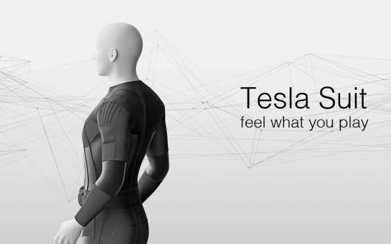
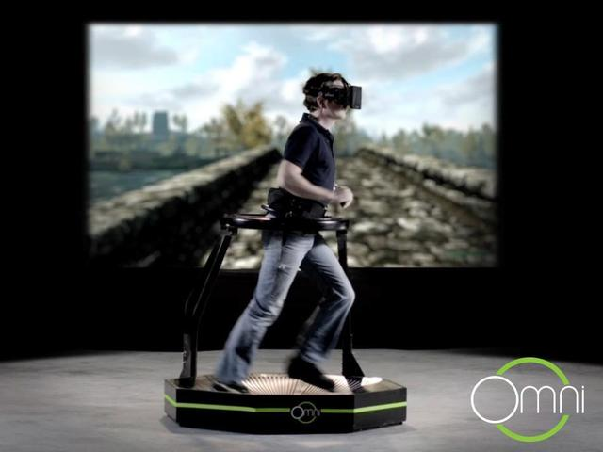
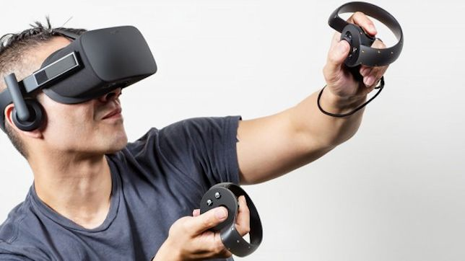
Current-Generation
Current generation of VR’s include the HMD devices like Occulus RIFT,THE VIVE and Google CardBoard. Todays generation also sports a treadmill know as omnitrix treadmill and it also features external perception suits like the tesla suit which generates virtual environments like Heat, cold ,Touch etc.

Slide 8
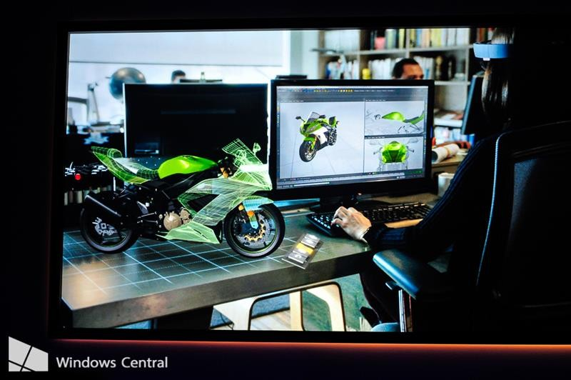

Application
VR has huge application not just in entertainment but in education , research and Robovision.
Education-It can be used as an interactive media , where students can interact and gain first hand experiences at low cost. It can have wide spread uses especially in the field of medicine where ,students studying to be doctors can use this to study cadavers virtually rather than original one for which the availability is limited.
Research-This has wide spread application in research where data's and observations can be shared. For example a geologist may share a peculiar rock formation with his colleagues for further analysis. An architect may share his plans for a new construction virtually .This will bring down the research duration to a minimum. It can also be used for visual feedback while controlling rovers ,This approach was used in curiosity and is planned to be used on chandrayaan-2.

Slide 9

Nasa Tech Demo

Slide 10
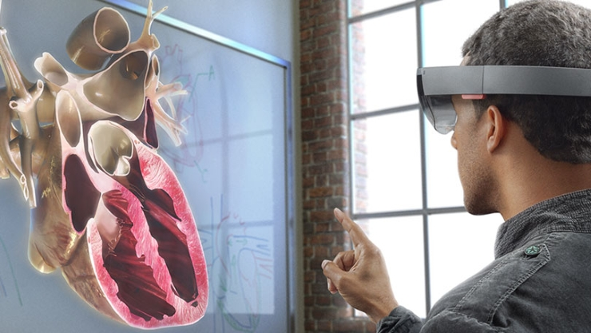
Education

Slide 11
Aim
This project is not to develop VR as an separate product , But integrate all the precursor efforts taken in the past into a single platform in a low cost economic model. Also to Bring in the necessary software and hardware design in such a way it can be easily modified and further developed by the vibrant open source community.

Slide 12
Objectives
Current VR system is based on windows and android platforms. Our VR unites these both as a single platform .It will also feature SBS 3D and Head Tracking.
Adds gesture control using a sensor glove that has flex and IMU .

Slide 13
Design Methodology and Project Plan
This project makes use of 2 developmental Boards –dragonBoard 410c and Arduino Leonardo. Sensors include 2 IMUs and Flex Sensors. This project also Makes use of High PPI Display-TF60006A.
Dragon Board was chosen to harness the android platform for it has the most powerful processor available in the market for a development board. Leonardo was chosen for gesture as it is the only Arduino platform along with DUE to provide support for Mouse and keyboard libraries.
The IMUs use MPU-6050 architecture embedded on a breakout board with inbuilt logic level conversion .This board is knows as GY-521.Flex sensor are resistor strips whose value changes when it is bent.
A stripped of google cardboard with Bifocal lens will act as skeleton to hold the elements of HUD’S.

Slide 14
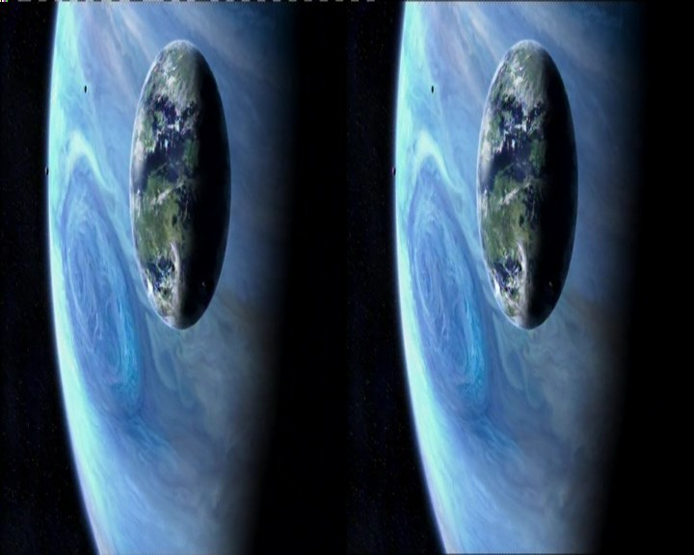
Softwares used are Tridef, SweetFX,Arduino programming interface.
Tridef is a indie developed graphics injector. Injectors are softwares that highjack GPU pipe lines make necessary modification to the video data and sends it back to the pipe line.This software is used to simulate a Side by Side 3D output.SBS 3D are images nothing but two images placed closed together with one image is viewed at slightly different angles .These 2 images are made to appear as they were from a single source by using bifocal lenses to trick the brain into thinking it is seeing a 3D objects.
SweetFx is a set of libraries that were designed by open source Modding communities to improve textures and filters of a program. We are using this to create the vignette effect to account for lens distortion. Originally used by modders to create scope like effect for applications , we are using it for different purpose .
Arduino programming interface is used to code Arduino for control applications.
The dragon Board must also be programmed and kernel level changes must be made to force android to accepts inputs of gyroscope via low speed expansion I2C ports.
For Tech Demo we are planning to use Google earth and Mirrors edge .

Slide 15
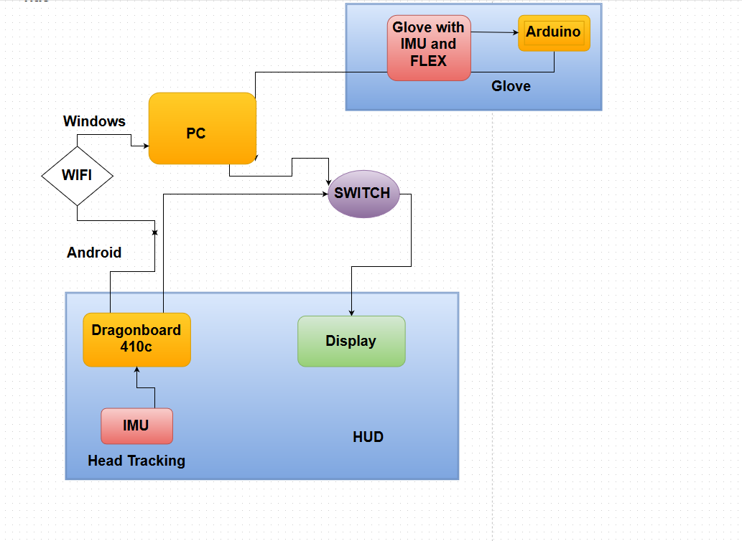

Slide 16
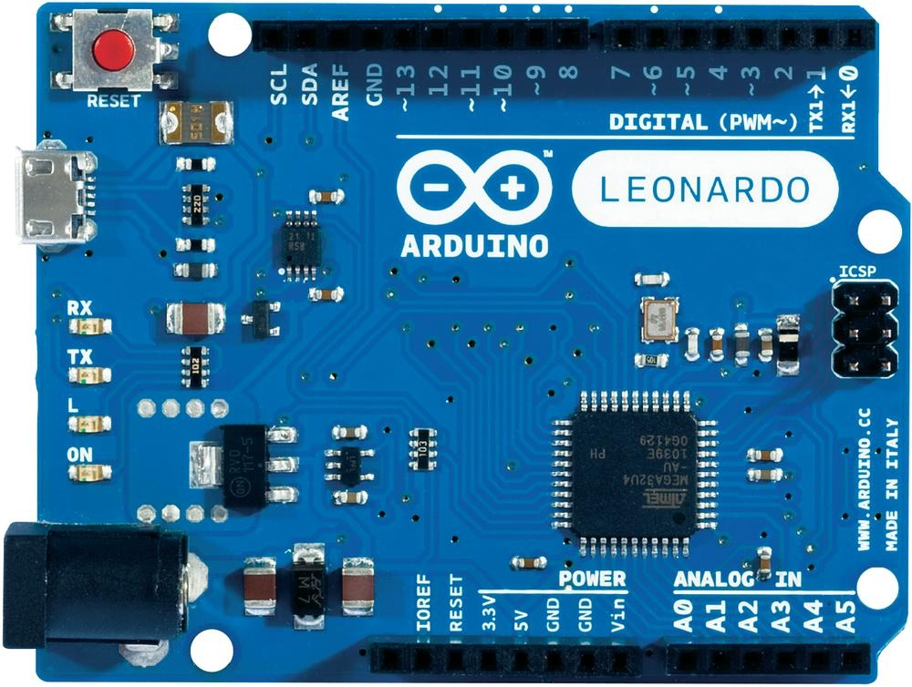
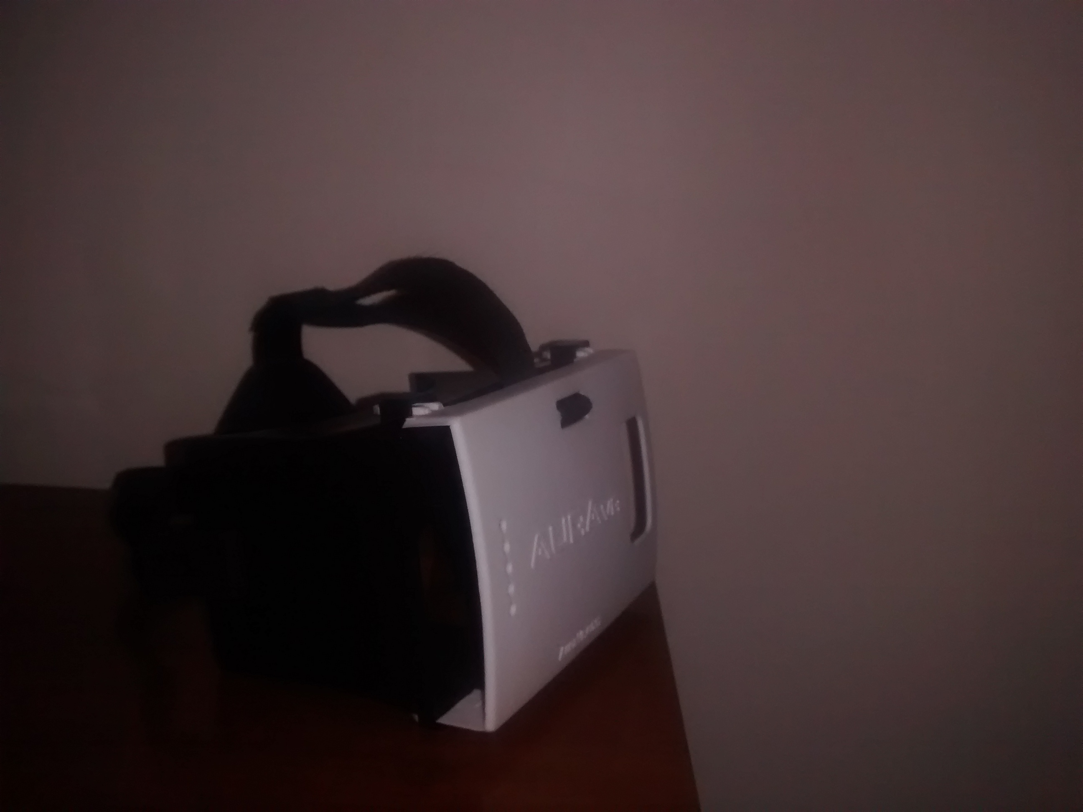
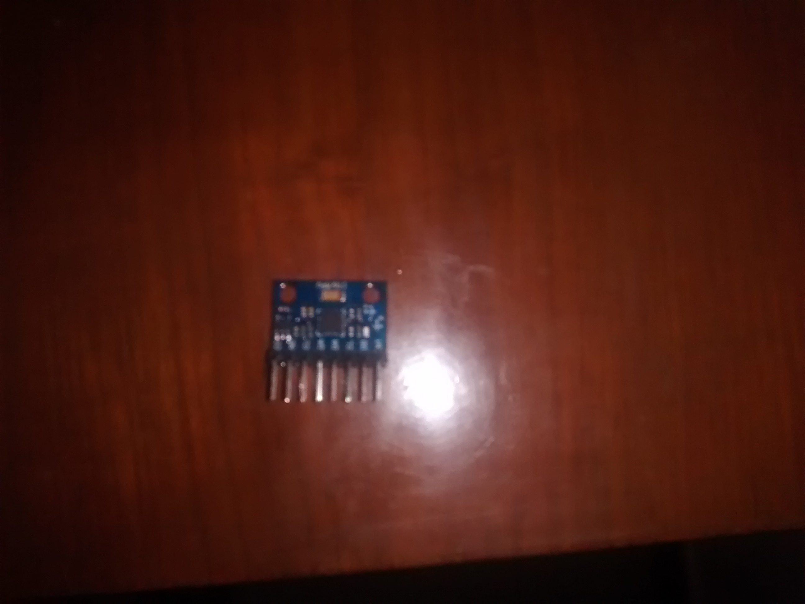
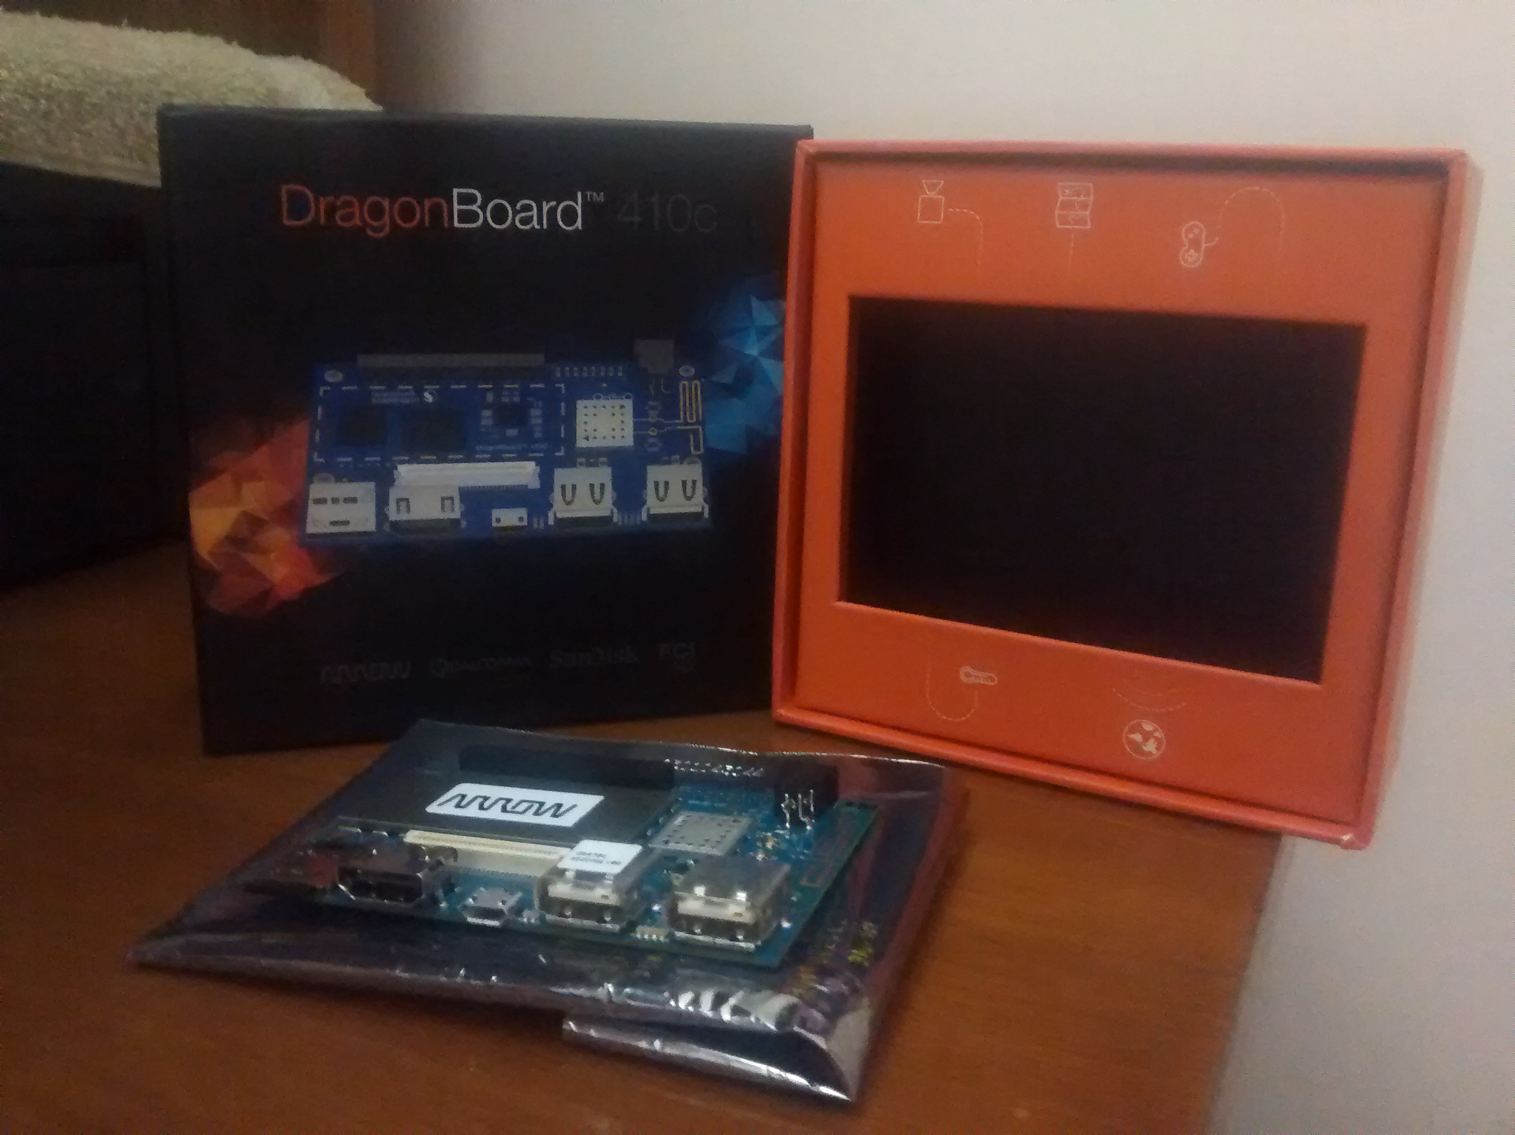
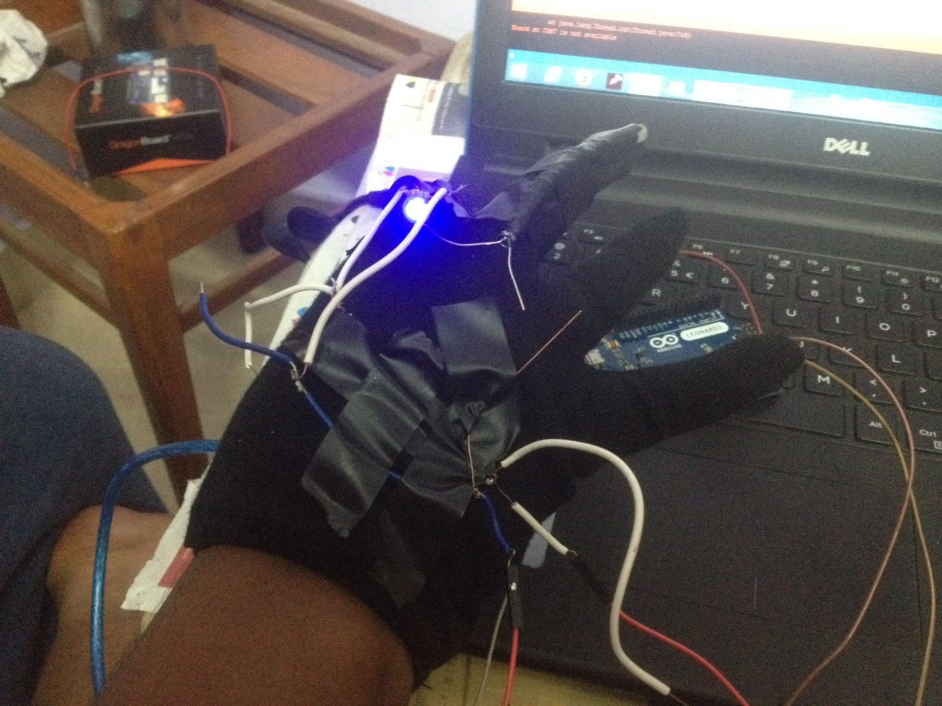

Slide 17
Budget
S.NO | Item / Parts | Supplier/ Manufacturer | Model No./ Description | Quantity | Unit Price | Total (Rs.)
1 | DragonBoard410c | Qualcomm | 410C | 1 | Rs4,000 | Rs4,000
2 | Display | Topfoison shenzden displays | TF60006A | 1 | Rs3,800 | Rs3,800
3 | Gyroscope GY-521 | roborium | GY-521 | 2 | Rs199 | Rs199
4 | LVL shifter Breakout | NIL | 3-5v variant | 1 | Rs200 | Rs200
5 | Google cardboard | Aura | Cardboard | 1 | Rs659 | Rs659
6 | PC with HDMI | NIL | NIL | 1 | NIL | NIL
7 | Arduino Leonardo | Genuino | Leonardo | 1 | Rs700 | Rs700
8 | Glove | Nil | Nil | 2 | Rs300 | Rs600
9 | Flex Sensor | Roborium | 2” | 4 | Rs540 | Rs2160
 | Total (Rs.) |  |  |  |  | Rs12,319

Slide 18
Contributions
Bringing all fragmented technology in the field of VR into a single form factor.
Highly economic compared to yet to be released VR like Occulus rift (600$).
Easy to make DIY Design.
Technology Demonstrator.

Slide 19
Conclusion
All the preliminary research work is done. All materials except display is Purchased. Project plan is formalized and integration work have started.
Just like how smartphones have revolutionized our day to day life, VR is going to open up lot of possibilities and revolutionize our lifestyle .

Slide 20
Bibliography and References
Applied virtual reality. In SIGGRAPH Course Notes 14. ACM SIGGRAPH, 1998.
AHLERS, K., AND KRAMER, A. Distributed augmented reality for collaborative design applications. Tech. rep., European Computer Industry Research Center, 1995.
AIREY, J. M., ROHLF, J. H., AND BROOKS, JR., F. P. Towards image realism with interactive update rates in complex virtual building environments. Computer Graphics (1990 Symposium on Interactive 3D Graphics) 24, 2 (Mar. 1990), 41–50.
APPINO, P., LEWIS, J. B., KOVED, L., LING, D. T., RABENHORST, D. A., AND CODELLA, C. F. An architecture for virtual worlds. Presence: Teleoperators and Virtual Environments 1, 1 (1992), 1–17.
BALAGUER, J.-F., AND DE GENNARO, S. VENUS: A virtual reality project at CERN. Computer Graphics 30, 4 (Nov. 1996), 40–48.
BALAGUER, J.-F., AND GOBBETTI, E. i3D: a high-speed 3D Web browser. In 1995 Symposium on the Virtual Reality Modeling Language (VRML ‘95) (Conference held in San Diego, CA, USA, Dec. 1995), ACM Press, pp. 69–76.
BALAGUER, J.-F., AND GOBBETTI, E. i3D: A high speed 3D web browser. In VRML: Bringing Virtual Reality to the Interet, J. R. Vacca, Ed. AP Professional, Boston, MA, USA, 1996.
BALAGUER, J.-F., AND MANGILI, A. Virtual environments. In New Trends in Animation and Visualization., D. Thalmann and N. Magnenat-Thalmann, Eds. Wiley, New York, NY, USA, 1992.
BALET, O., LUGA, H., DUTHEN, Y., AND CAUBET, R. PROVIS: A platform for virtual prototyping and maintenance tests. In Proceedings IEEE Computer Animation (1997).

Slide 21


